Slide 1

Deloitte Pre Hire Training
2017
FOUNDATION TRAINING
Spring Core

Slide 2
Core Spring
Transaction Management

Slide 3
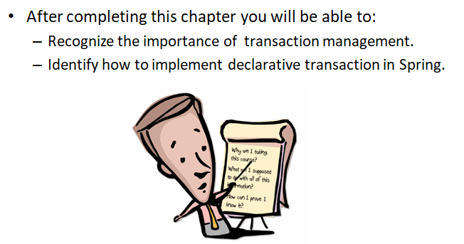
Objectives

Slide 4
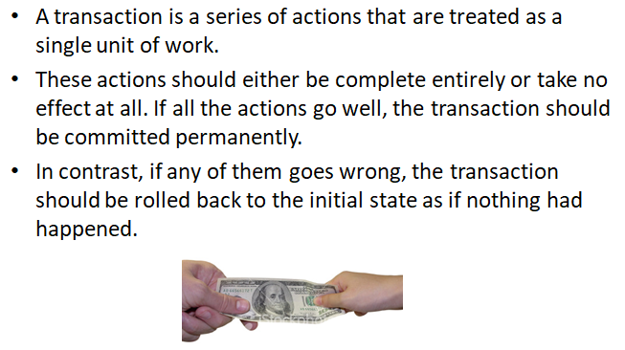
What is a Transaction?

Slide 5
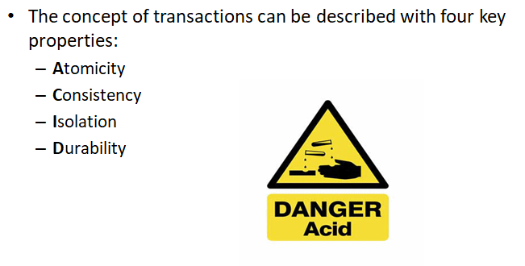
ACID

Slide 6
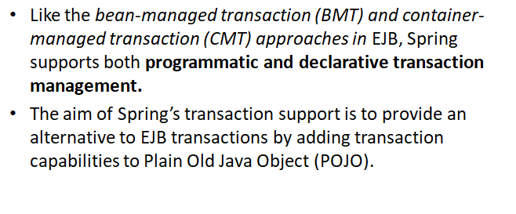
Spring Transaction Management

Slide 7
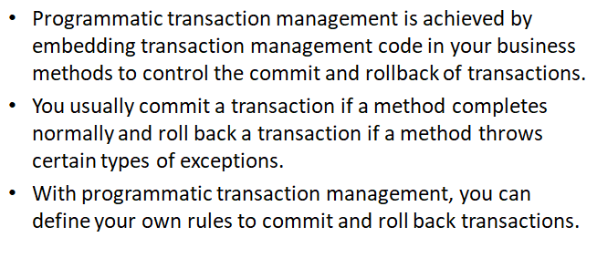
Programmatic Transaction Management

Slide 8
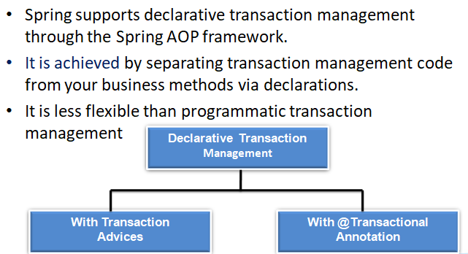
Declarative Transaction Management

Slide 9
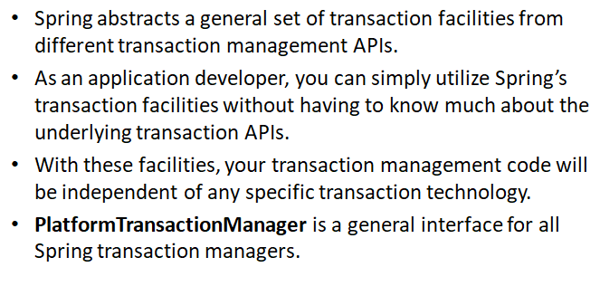
Spring Transaction Manager

Slide 10
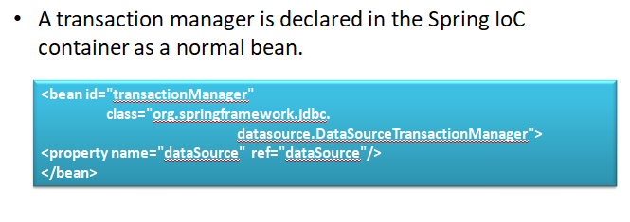
Spring Transaction Manager

Slide 11
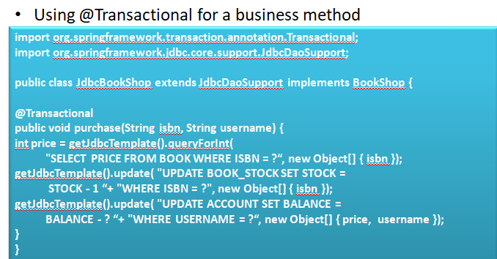
@Transactional Annotation

Slide 12
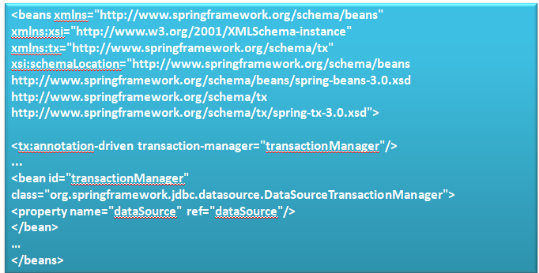
@Transactional Annotation in Spring Configuration File

Slide 13
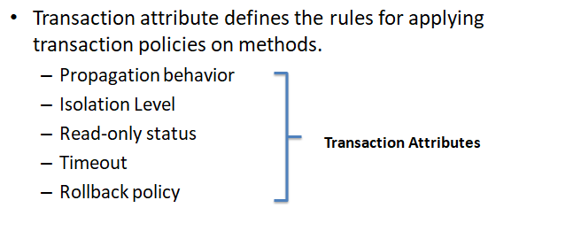
Transaction Attributes

Slide 14
Demo
Code to configure transaction manager in spring configuration file and usages of @Transactional annotation with attributes.

Slide 15
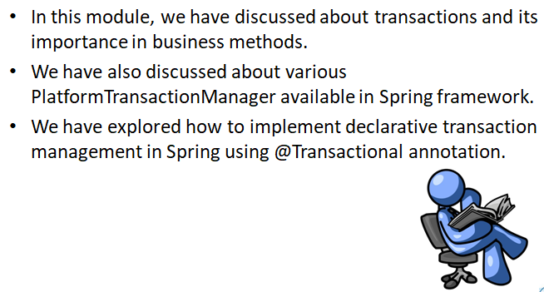
Summary

